Slide 1

Inductive Text Classiﬁcationvia Graph Neural Networks
汇报人：TangGu
时间：2020.4.28
Paper:https://arxiv.org/abs/2004.13826
Meeting:ACL 2020
Code:https://github.com/CRIPAC-DIG/TextING

Slide 2
1
Background
Disadvantages of traditional GCN:
1 Global Graph can only be constructed based on Corpus, but ignore the local structure of a single document
Doc 1
Build graph
Doc 2
Doc 3
Doc 4
Doc 5
Demo: 1. So delicious was the noodles but terrible vegetables.
2. The noodles in this shop are terrible

Slide 3
Backgroud
Disadvantages of traditional GCN :
2.Traditional GNN cannot model new documents resulting in insufficient generalization ability
Doc 1
Build graph
Doc 2
Doc 3
Doc 4
Doc 5
New doc（include new words）

Slide 4
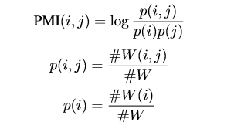


TextING-Buildgraph
construct the graph for a textual document by representing unique words as vertices and co-occurrences between words as edges, denoted as
$$G\text{=}（V，ξ）$$
where V is the set of vertices and the edges.
$ξ$
Default windows size is 3

Slide 5
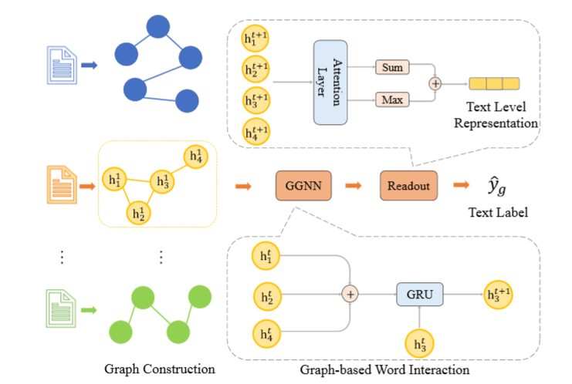
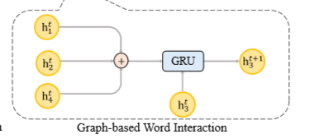
TextING-GRU GNN
Model architecture:
GRU-GNN

Slide 6
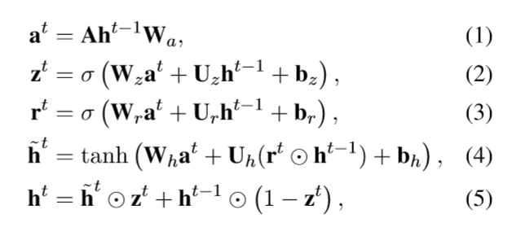
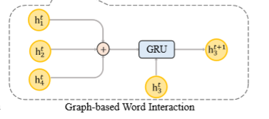
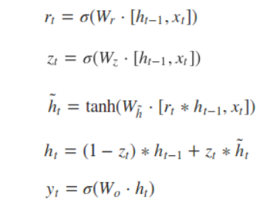
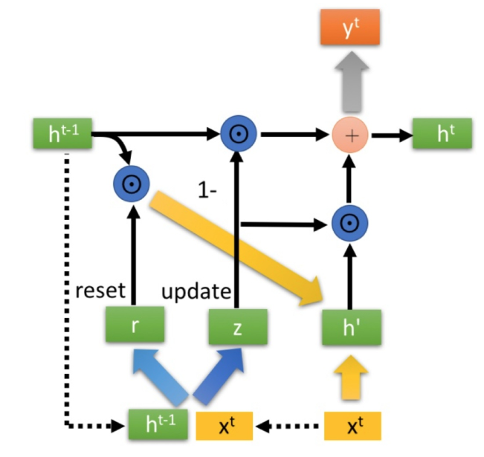
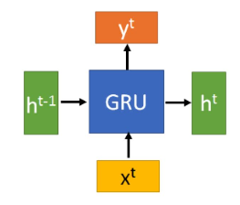
TextING-GNN-GRU
contrast
RNN-GRU

Slide 7
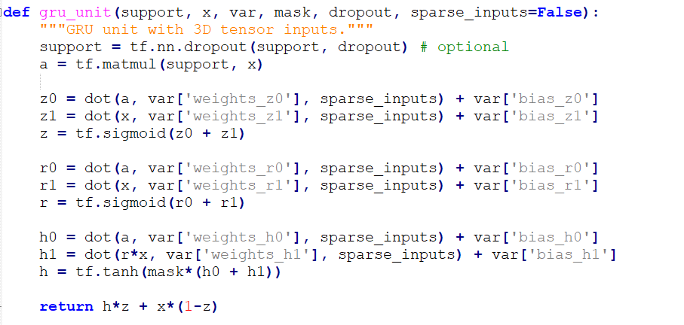
TextING-GNN-GRU

Slide 8
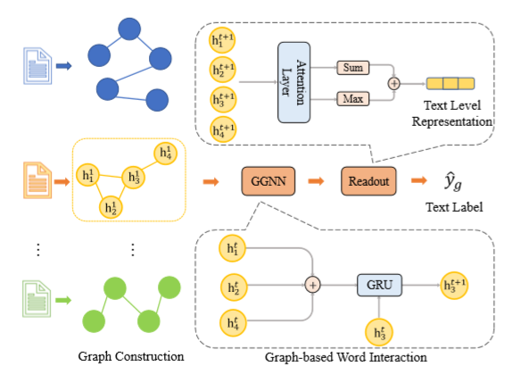



TextING-Readout Function
where f1 and f2 are two multilayer perceptrons (MLP).
Case study:
Dataset of MR

Slide 9
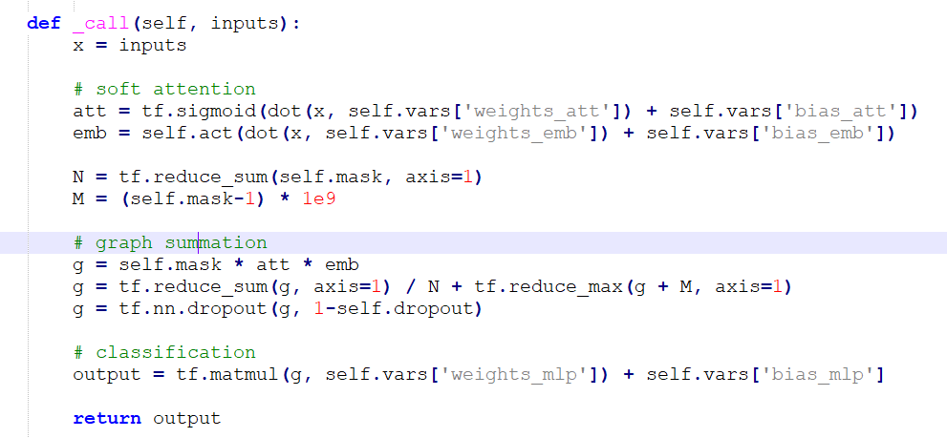
TextING-Readout Function

Slide 10
TextING-M
Doc graph
GGNN
Readout
Output
Doc
GGNN
Readout
subgraph
Graph of corpus

Slide 11
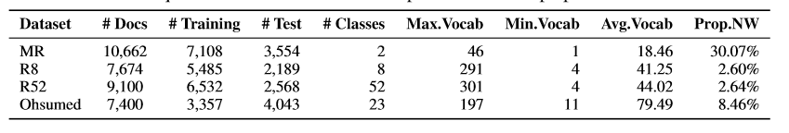
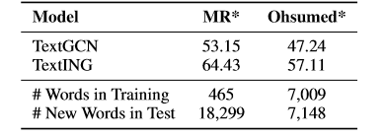
Experiments-Dataset and Result
Acc of TextGCN and TextING on MR and Ohsumed, where MR uses 40 labelled documents (0.5% of full training data) and Ohsumed uses 460 labelled documents (13.7% of full training data)

Slide 12
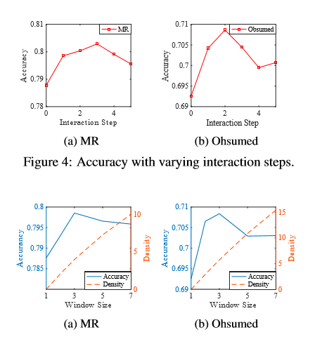
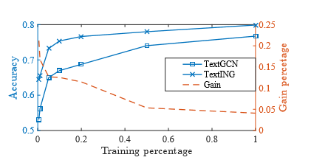
Experiments-Dataset and Result

Slide 13
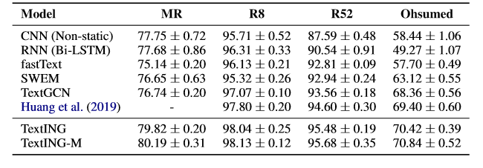
Experiments-Dataset and Result

Slide 14
THANGKS!

